Slide 1


Suitable Web Programming Languages
& Web Constraints
Subject Name: Platform Based Development
Subject Code: PBDV301 | PBDE401
Lecturer Name : Freedom
Department : Information Technology

Slide 2

Web Programming Languages
Suitable web programming languages
When building a client-side interactive web application, the most suitable language is often:
A) JavaScript
B) Python
C) C++
D) PHP

Slide 3
Web Programming Languages
Suitable web programming languages
For a web app that relies heavily on server-side computations and machine learning models, which factor is most relevant?
A) Integration with data processing libraries
B) Ability to manipulate the DOM
C) Built-in animation libraries
D) Support for HTTP cookies

Slide 4

Web Programming Languages
Suitable web programming languages
A startup wants a fast time-to-market with minimal coding effort. Which factor is most important in language selection?
A) Rapid development frameworks
B) Advanced concurrency control
C) Low-level memory management
D) Multi-threading

Slide 5
Web Programming Languages
Suitable web programming languages
Which factor is key when the web application needs to handle sensitive user data?
A) Language popularity
B) Security features and built-in sanitization
C) Support for functional programming
D) Ability to run offline

Slide 6
Web Programming Languages
Suitable web programming languages
Which factor is most important when selecting a web programming language for a high-traffic, real-time web application?
A) Syntax readability
B) Concurrency and performance
C) Availability of GUI libraries
D) Ease of embedding in HTML

Slide 7
Web Programming Languages
Suitable web programming languages
If a project requires rapid prototyping and integration with data analytics tools, which factor should weigh most heavily in choosing a language?
A) Community support and libraries
B) Ability to compile to machine code
C) Multi-threading support
D) Low-level memory management

Slide 8
Web Programming Languages
Suitable web programming languages
Which factor is crucial when selecting a language for a large-scale application maintained by a distributed team?
A) Type safety and maintainability
B) Browser compatibility
C) Speed of execution
D) Ability to run without a server

Slide 9

Web Programming Languages
Suitable web programming languages
There are a number of parameters (factors) to consider:
  Project requirements (e.g. type of application and features)
  Popularity,
  Demand,
  Budget,
  Performance,
  Support,
  Learning curve,
  Reliability, and more.

Slide 10
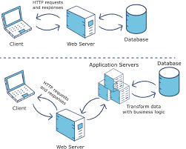
Web Platform Constraints
Server dependency

Slide 11
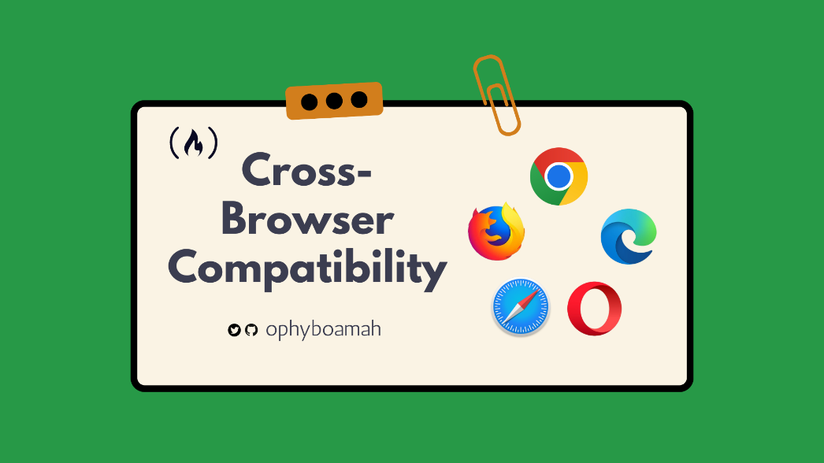
Web Platform Constraints
Browser Incompatibility

Slide 12

Web Platform Constraints
Server dependency
Browser incompatibility
Lack Responsiveness
Internet reliance
Reduced Speed / Performance
Less Security
No visibility
Restricted Functionality
Compliance with data related laws
…and more

Slide 13

Summary
Language Choice Factors
  Consider project type, performance, scalability, maintainability, ecosystem, security, team skills, and cost.
  Match the language to the project requirements .
Common Web Constraints + Solutions
  Browser incompatibility, server dependency, lack of responsiveness, internet reliance, reduced speed, security risks, limited visibility, restricted functionality, and legal compliance are major challenges.
  Solution techniques include cross-browser testing, caching, service workers, lazy loading, CDNs, SSR, security best practices, analytics, and feature fallbacks.
  Optimize performance, security, and user experience together.
Key
  Balance speed-to-market vs maintainability, offline functionality vs internet dependence, and feature richness vs device/browser constraints.
  Use modern frameworks and tools to maximize functionality while minimizing limitations

